Slide 1



Welcome Back!
September 1, 2026
🌐 www.roycloudpto.com
✉ info@roycloudpto.com
Connect with Roy Cloud PTO:

Slide 2
Agenda
Welcome & Introductions - PTO Overview 5 min
Fundraising Update 5 min
Programs Update 2 min
Guest Speaker: Each Green Corner 10 min
Upcoming Events & Activities 2 min
Volunteer Opportunities 2 min
Treasurer - Budget Discussion 10 min
Discussion with the Principal 10 min
Q & A 5 min

Slide 3
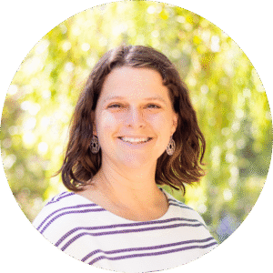
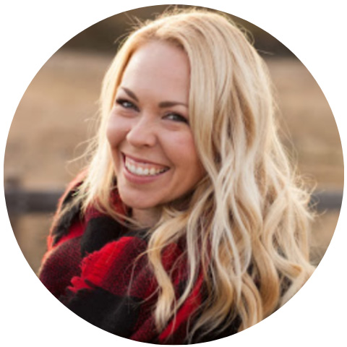
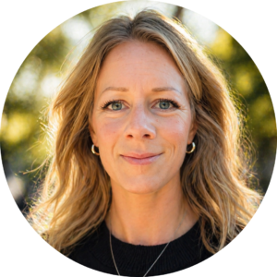

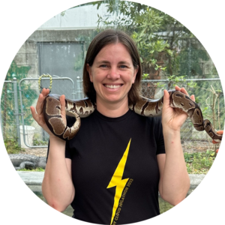
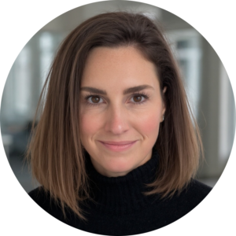
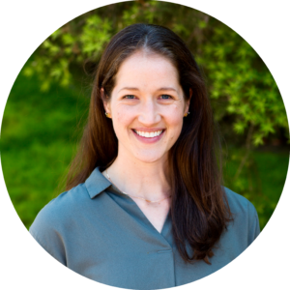
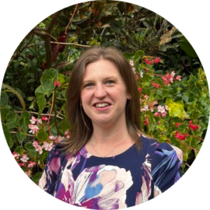
Meet Our Officers
President
Julie Costello
Treasurer
Leanna Staben
Vice President
Kelsey Chambers
Secretary
Kali Quinlan
Fundraising
Erin Levins
Parliamentarian
Christina Kennedy
Programs
Kayla Gupta
Communications
Allison Yates

Slide 4
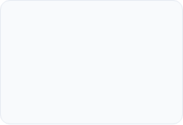


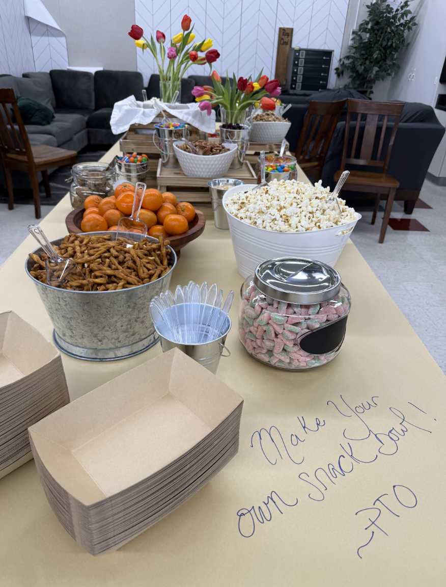

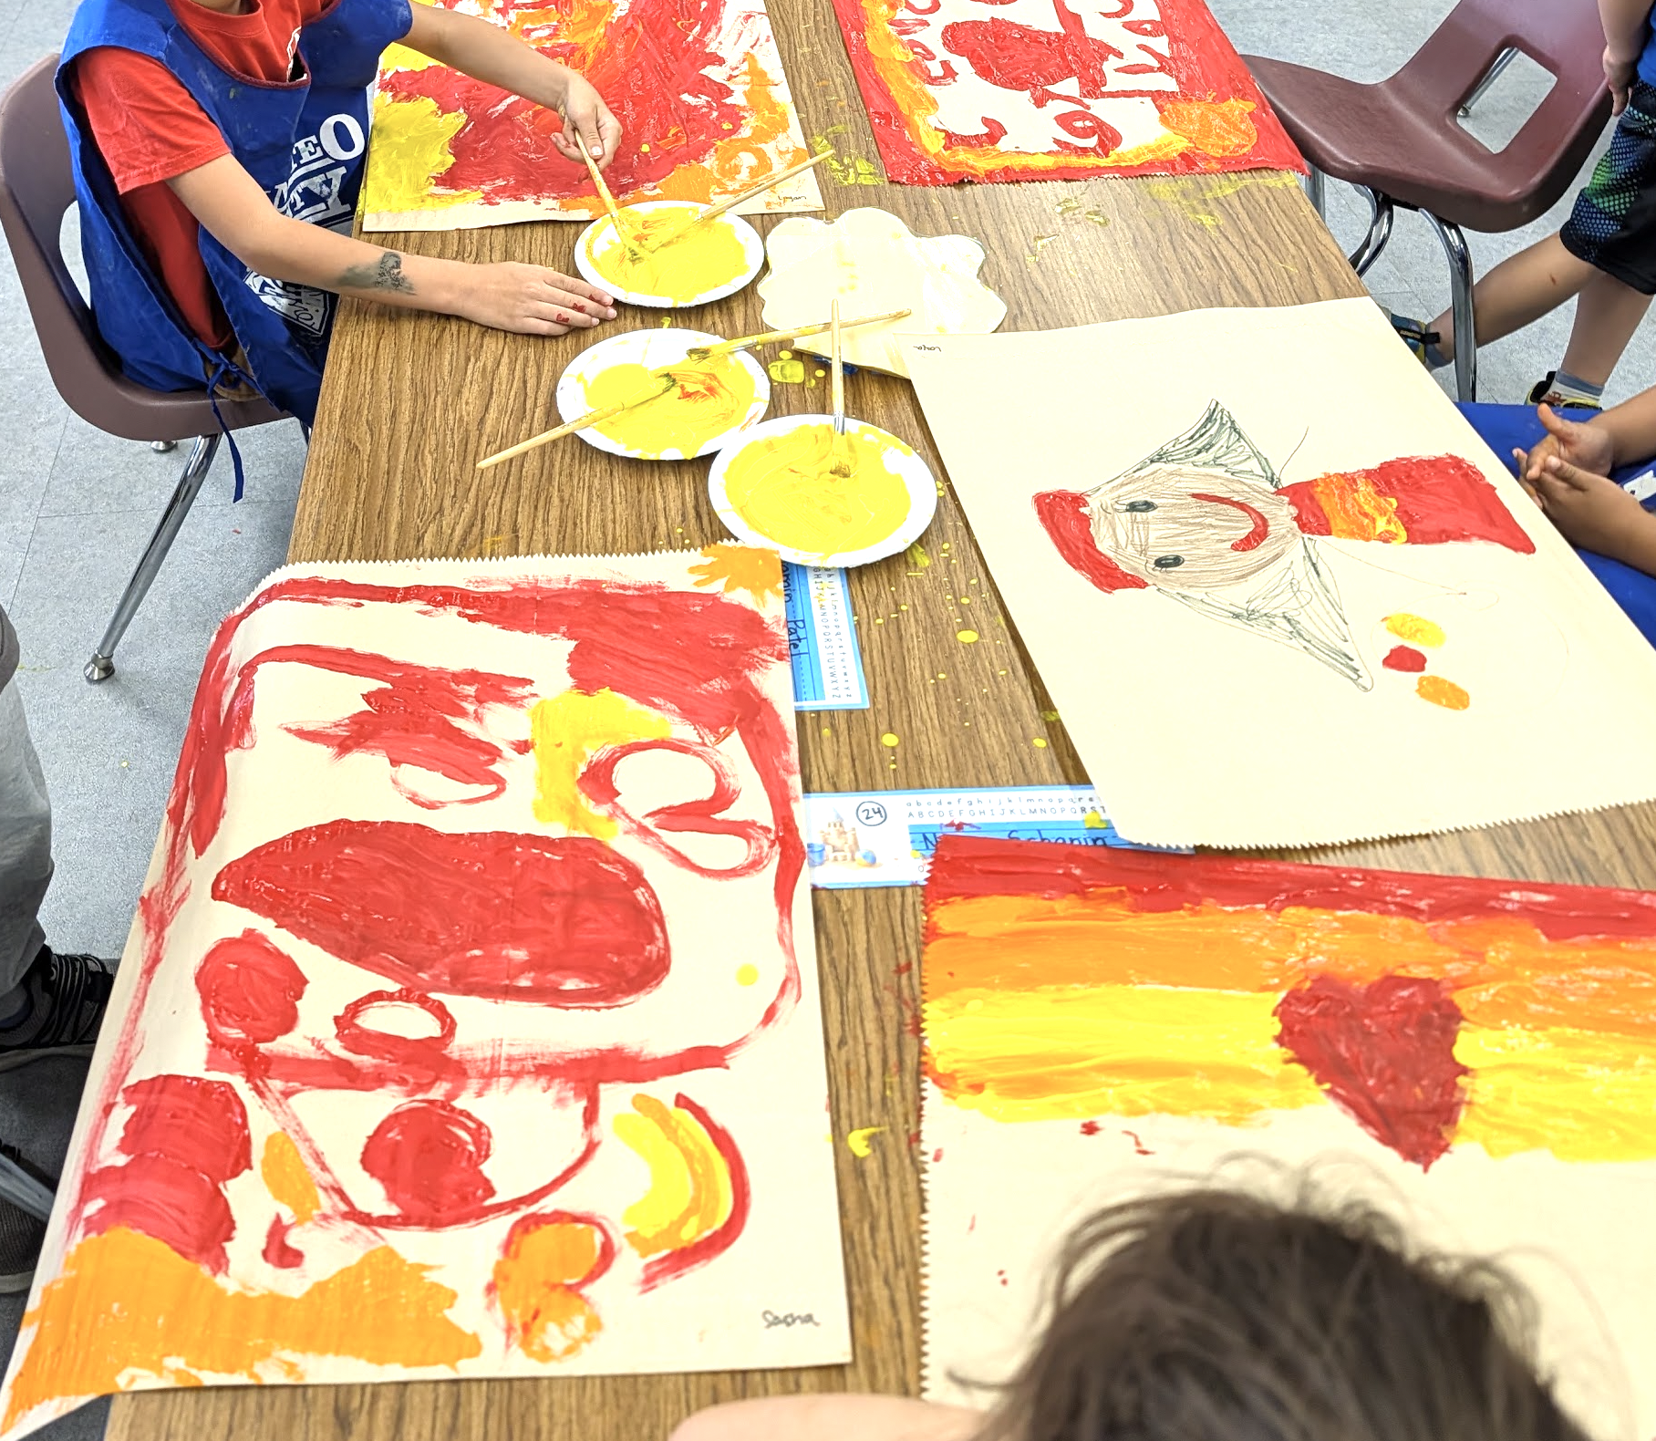
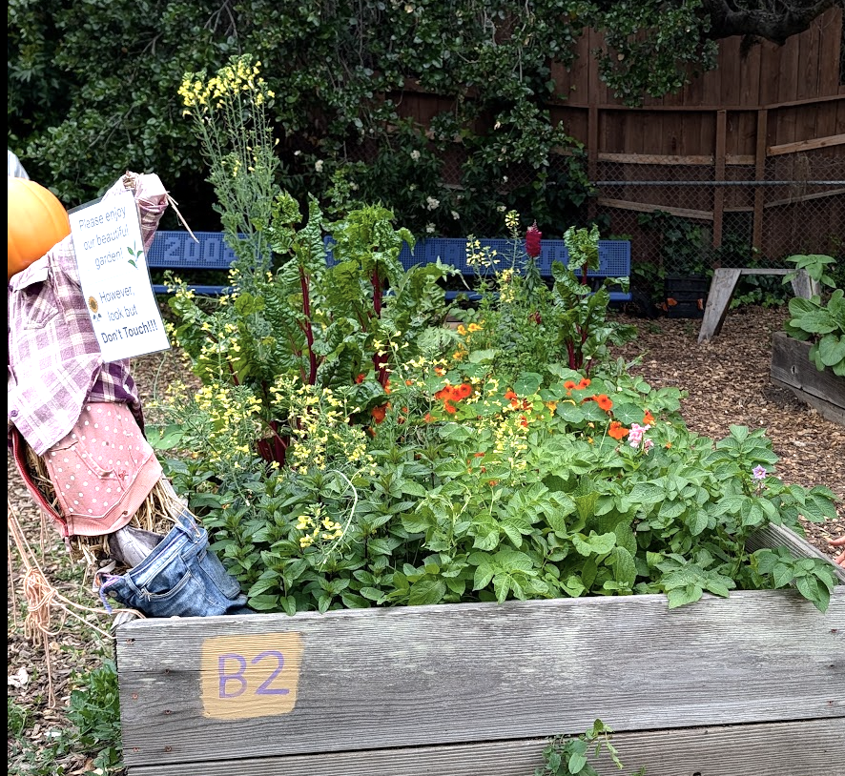
Student Enrichment & Learning
Classroom and Staff Support
Providing hands-on opportunities that enrich
every child's daily school experience.
Directly equipping our teachers and school with vital tools,
technology, and community events.
Art & Music
Direct Teacher Grants
Science
Field Trips & Bus Transport
Community Events
Garden
Tech & Classroom Equipment
Theater
Library & Counseling
Social Emotional
Staff Appreciation
Notes:
When you support the PTO, you help Roy Cloud be the school our kids deserve

Slide 5

YOU make all this possible!
No paperwork, no membership dues, no pressure...
EVERYONE IS A PTO MEMBER

Slide 6
PTO Meetings and Cadence
Upcoming Meeting Dates
Join us on the following Tuesdays:
September 1, 2026
November 10, 2026
January 12, 2027
March 2, 2027
May 4, 2027
Members
Officers
Executive Board
Bi-monthly
Tuesdays, 7:00 PM
Bi-monthly
Meeting cadence
Weekly
Meeting cadence
Roy Cloud Library

Slide 7
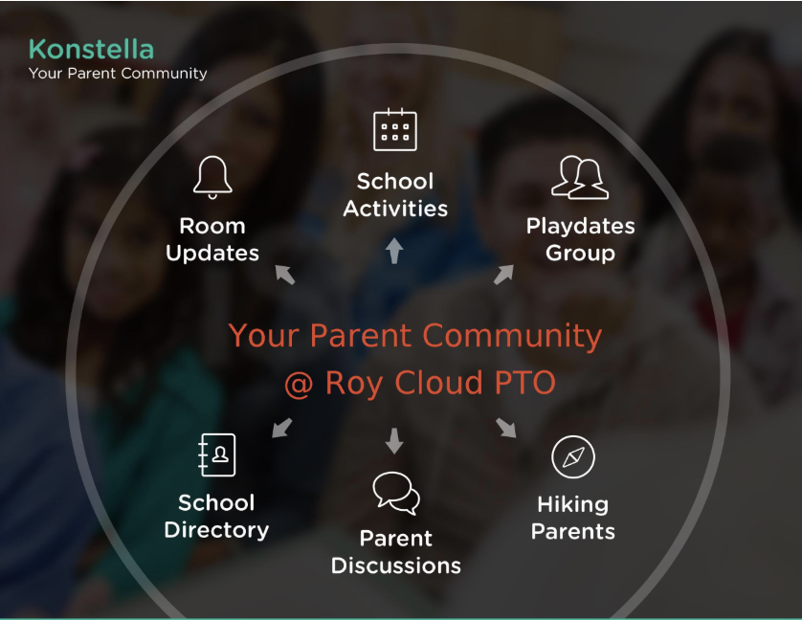
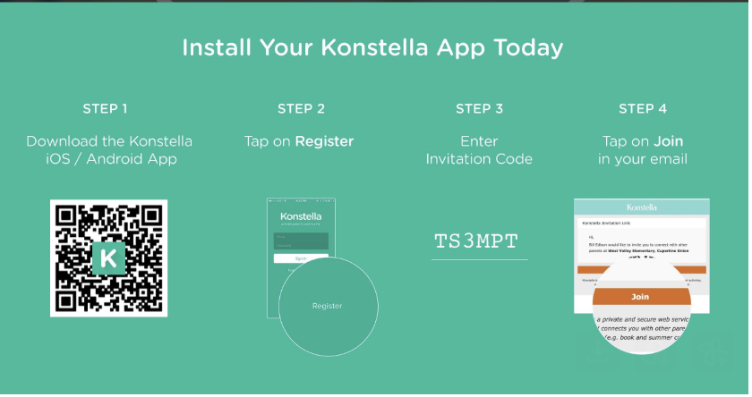
Stay Connected with Konstella
All caregivers are in their child’s classrooms. You’re set up and ready to go—so log in and get involved.

Slide 8

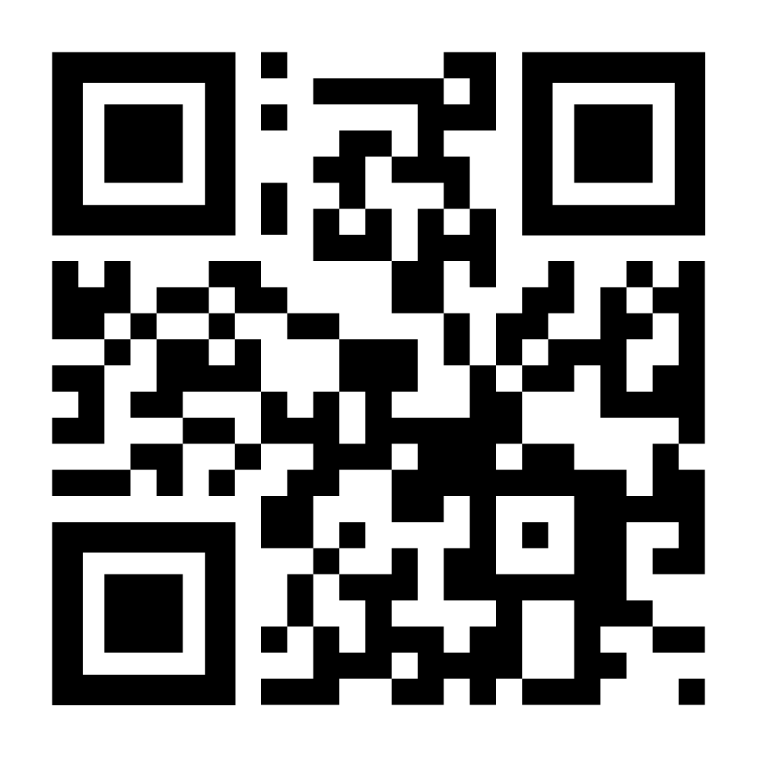
Growing Our Students' Bright Futures
~$1,000
Every program, event, and classroom enhancement that makes Roy Cloud extraordinary is funded and made possible through your annual PTO donations. Only 44% of families donated last year, every contribution makes a difference!
Direct Investment Per Student
Funded annually through parent donations & PTO volunteer efforts to deliver enriched education.
Donate

Slide 9

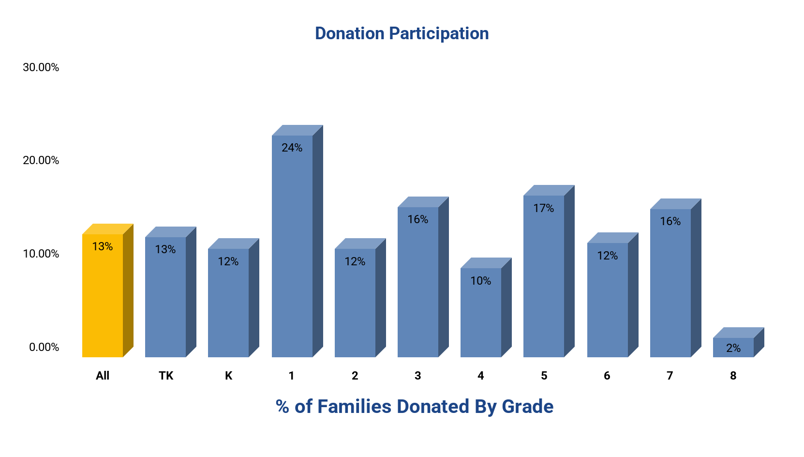
Raised to Date: $91,771
Pending Matches: $22,310
Total: $114,081
($7k above this time last year)
% of Goal: 42%
(goal is $270,000)
Days Left: 60
Participation: ~13%
(down 1% from this time last year, a donation in any amount counts)
Leading Grade: First (24%)
Join our DD committee to infuse new ideas and increase our fundraising impact!

Slide 10

Make Your Donation, Get Your Roy Cloud Supporter Magnet!

Slide 11
Programs Update
Character Strong SEL
Grades K-8
After-School Enrichment
Grades TK-8
Fall session starts after September 7th
Music with Mx. Washburn
Grades TK-8
Garden (Each Green Corner)
Grades TK-8
Art in Action
Grades K-8
Middle School Intercession
Grades 6-8
World Languages (Rosetta Stone)
Grades 6-8
STEAM
Grades K-8
Marine Science Institute
Grades TK-2
Science from Scientists
Grades 3-6

Slide 12
Middle School Intersession
What? Intersession is a two-week middle school program that replaces regular electives with hands-on, screen-free courses led by community members and local experts, giving students the opportunity to explore new interests and skills outside the traditional classroom.
Dates
  Session 1: October 26 – November 6, 2026
  Session 2: March 2 – March 12, 2027
Classes
Improv | Garden
Beading & Embroidery | Founder’s Lab
Engineering Creativity | Bike Maintenance
Art | TBD

Slide 13

Each Green Corner
Notes:
Tammi

Slide 14




Our mission is to educate and assist community members in growing sustainable and culturally-diverse food gardens, to create a pipeline of produce
for our communities.
eachgreencorner.org
@eachgreencorner
Each Green Corner

Slide 15
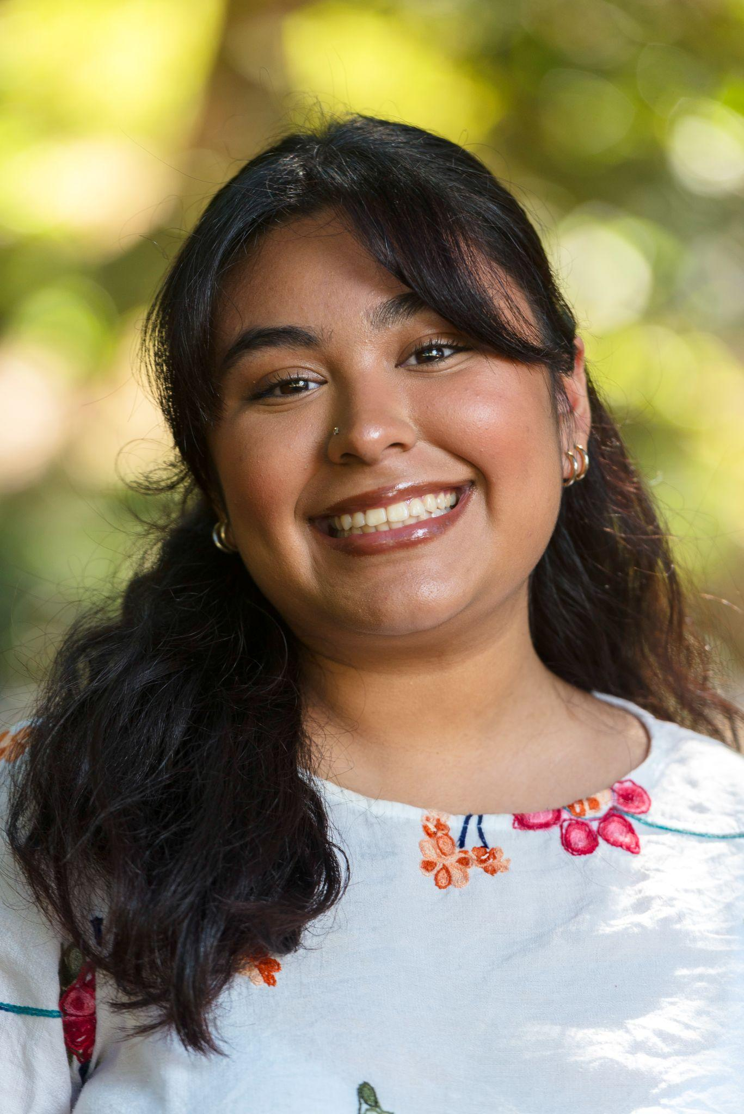
My name is Magaly Santos, and I am the new Food Systems Educator for Each Green Corner at Roy Cloud!
I am a second-year Master's student at the University of San Francisco studying Environmental Management. My love and enthusiasm for food systems stems from my home community in the Salinas Valley and my farmworker background.
Through advocacy and education, I hope to contribute to our communities and make food systems more sustainable and equitable for all!

Slide 16
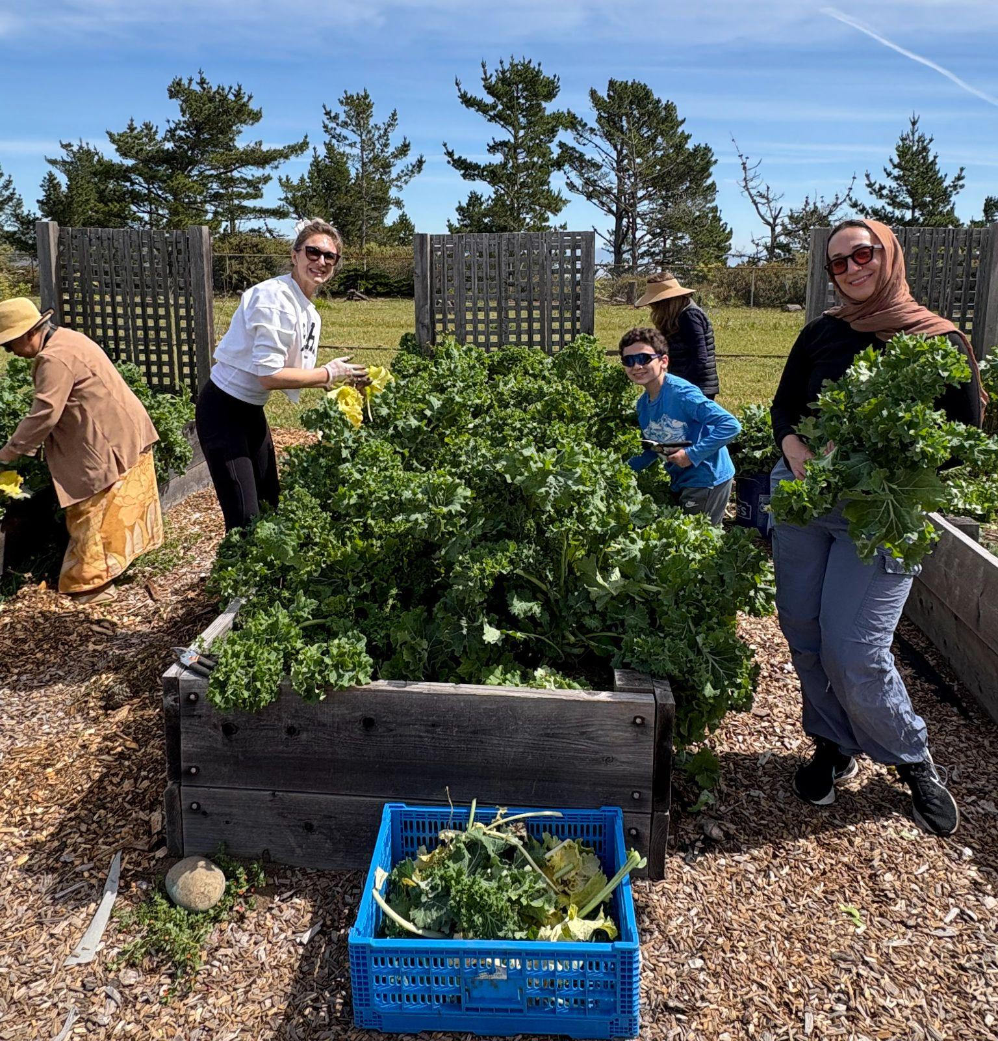
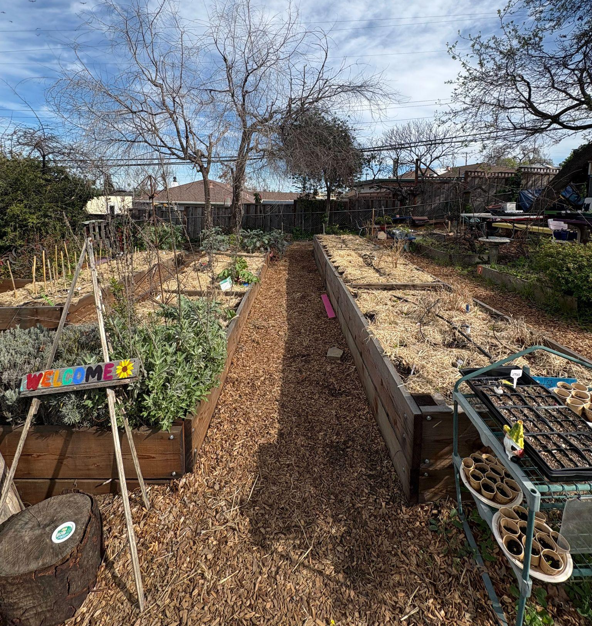
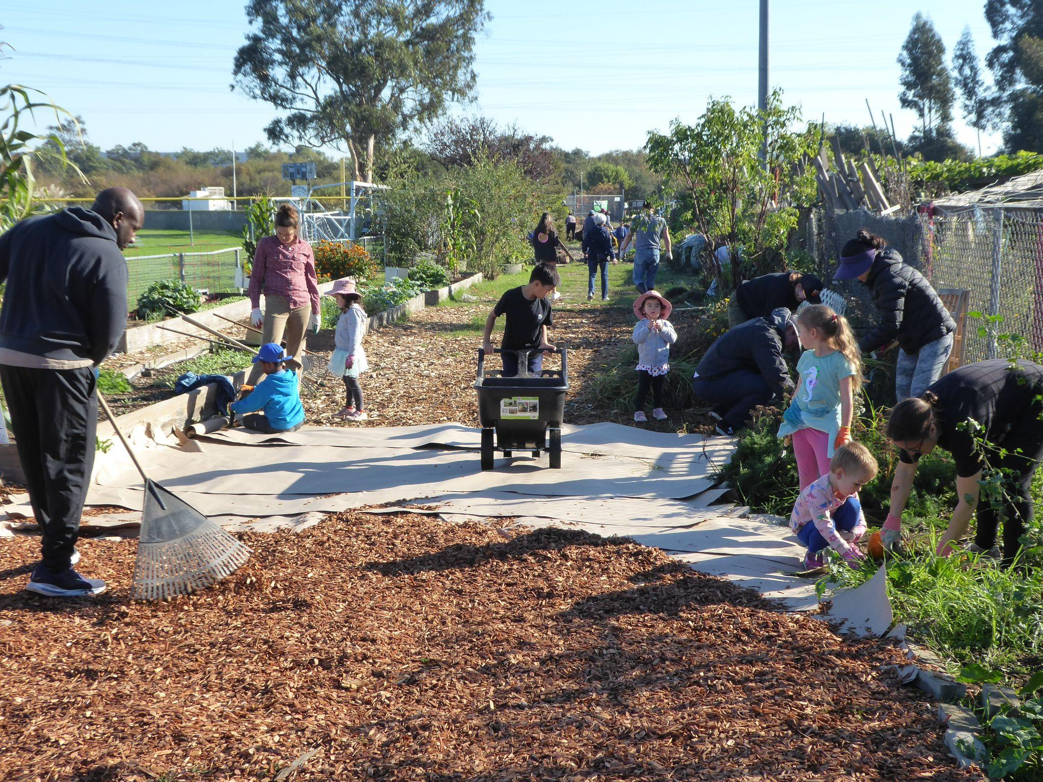
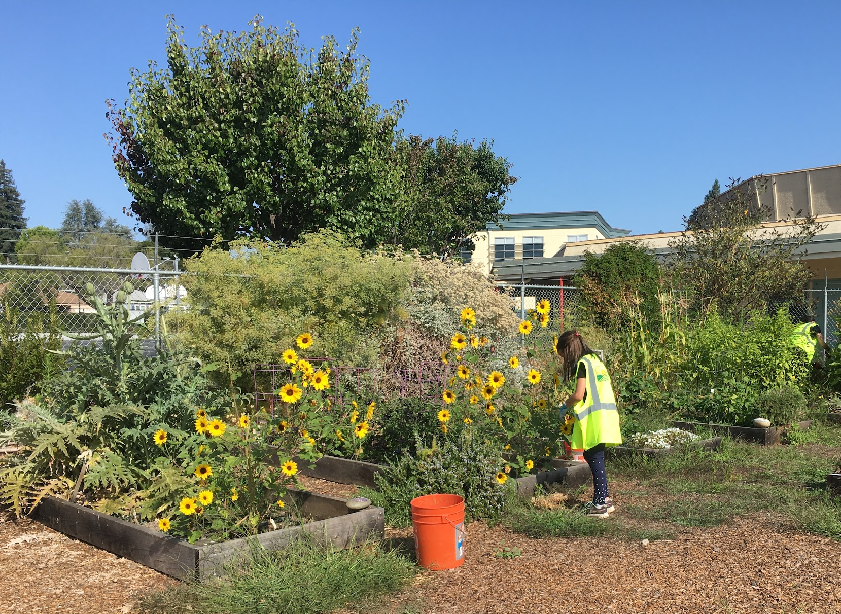
Living Campus Program
EGC partners with San Mateo County schools to create educational spaces within food-producing gardens on campus.
Our Living Campus program promotes sustainable agriculture, food justice, health awareness, physical activity and community engagement among all ages.
Provide Food Explorers Program curriculum and curriculum delivery support
Produce grown on campus is donated back to the community through local food banks, school pick-up programs and high school culinary education programs.
EGC works with the San Mateo County Sustainability Department, who provide us with small grant funds for garden site maintenance each school year.

Slide 17
Where are we?
EGC serves 15 garden sites throughout San Mateo County each year. We provide hybrid sites with supplies and materials, while our 8 current Living Campus sites receive school-day classes and monthly workday services.
Redwood City School District
  Roosevelt Elementary
  Roy Cloud School
  Orion Elementary
San Bruno Parks School District
  Portola Elementary
  Belle Air Elementary
  Allen Elementary
  John Muir Elementary
South San Francisco Unified School District
  Buri Buri Elementary School
Sequoia Union High School District
  Redwood High School
  Carlmont High School
San Mateo Union High School District
  Hillsdale High School
San Carlos School District
  Arroyo Upper Elementary
  Central Middle School
  Tierra Linda Middle School
Community Centers
  Boys & Girls Club of the Peninsula

Slide 18
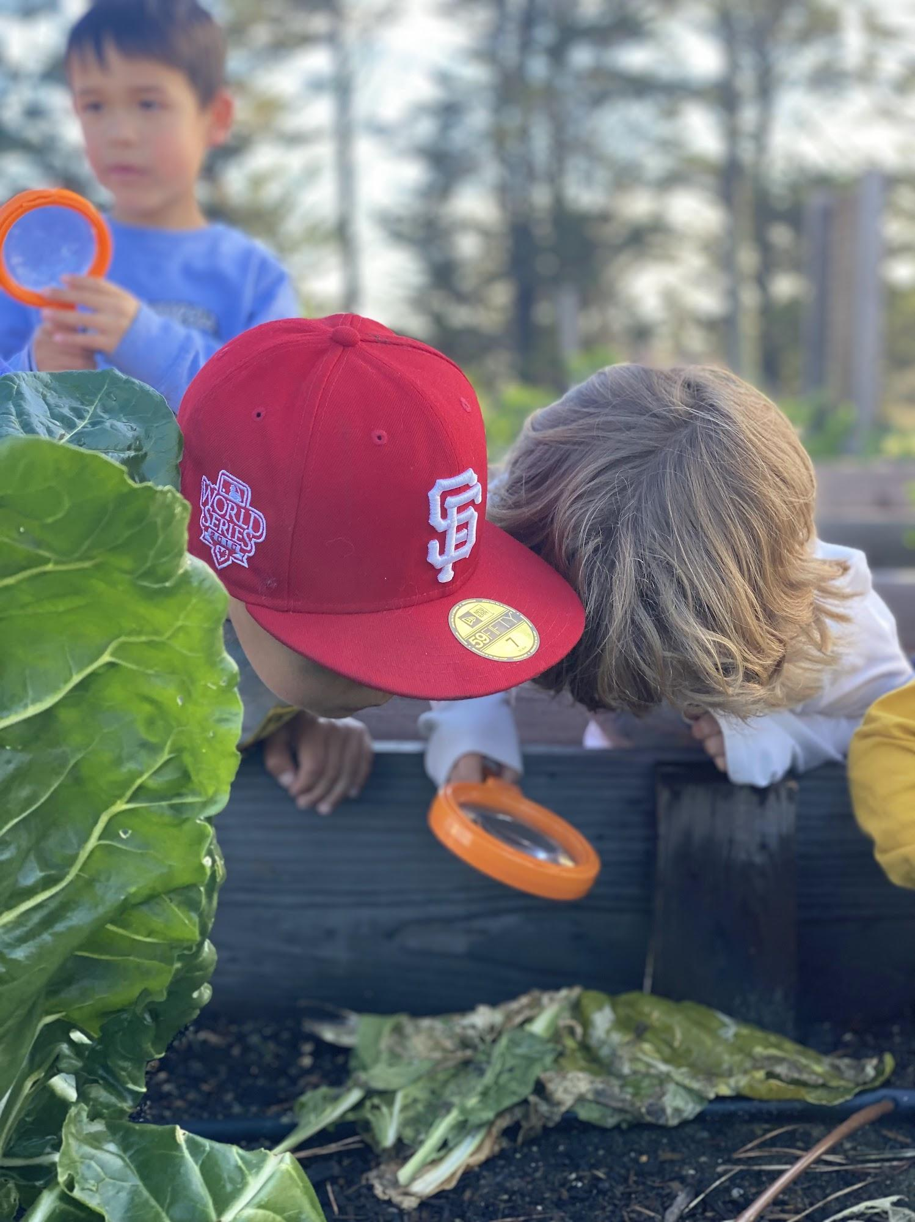
Food Explorers Program

Slide 19

Food Explorers is EGC’s school-day curriculum program for grades K-5 focused on food systems, sustainability, nutrition, community and food justice.
The first 5 months of K-3 classes focus on the 5 steps of the food system:
Production
Processing
Distribution
Consumption
Disposal
Our 4th/5th grade curriculum is primarily focused on plant science and systems, using project-based learning and science journaling.

Slide 20
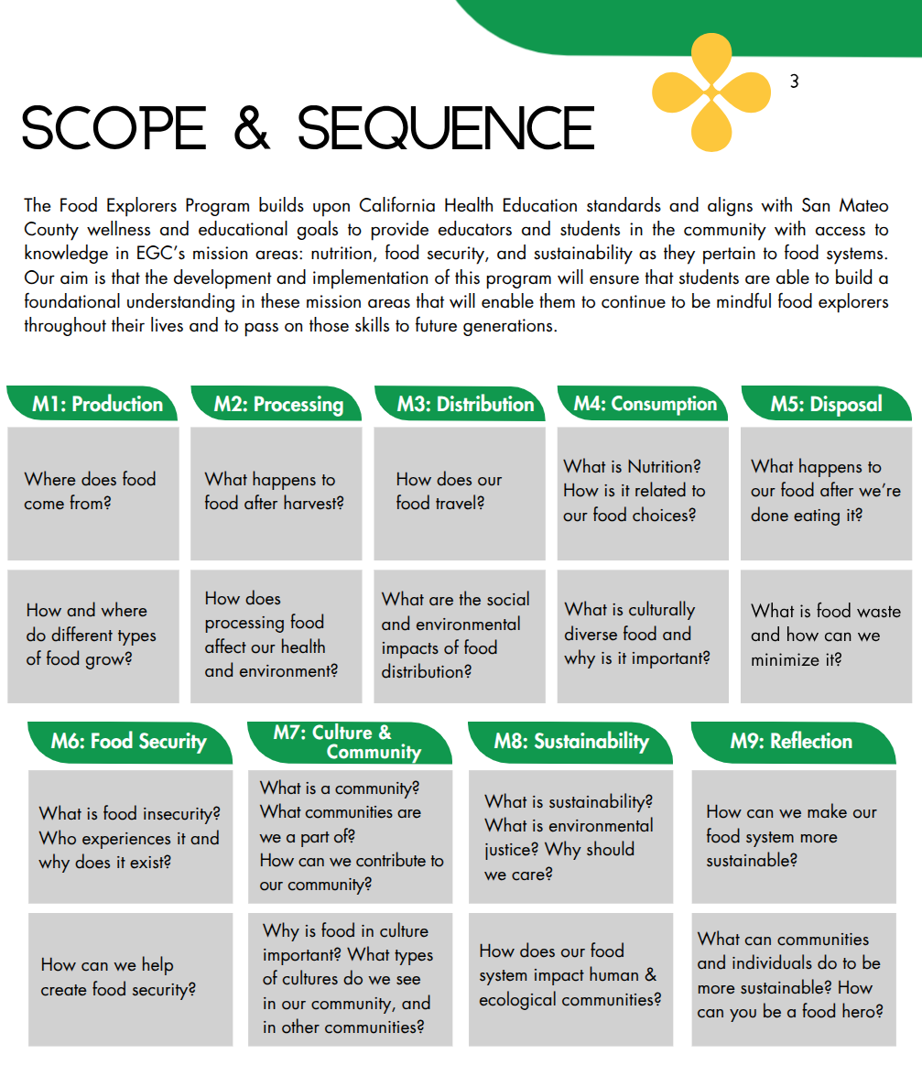
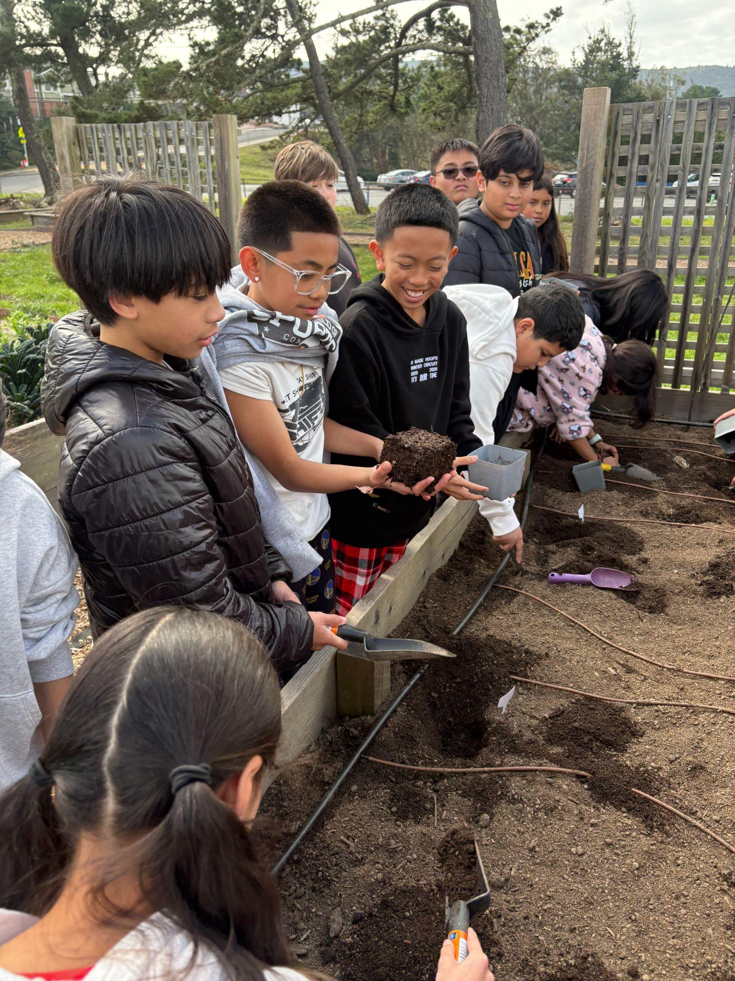
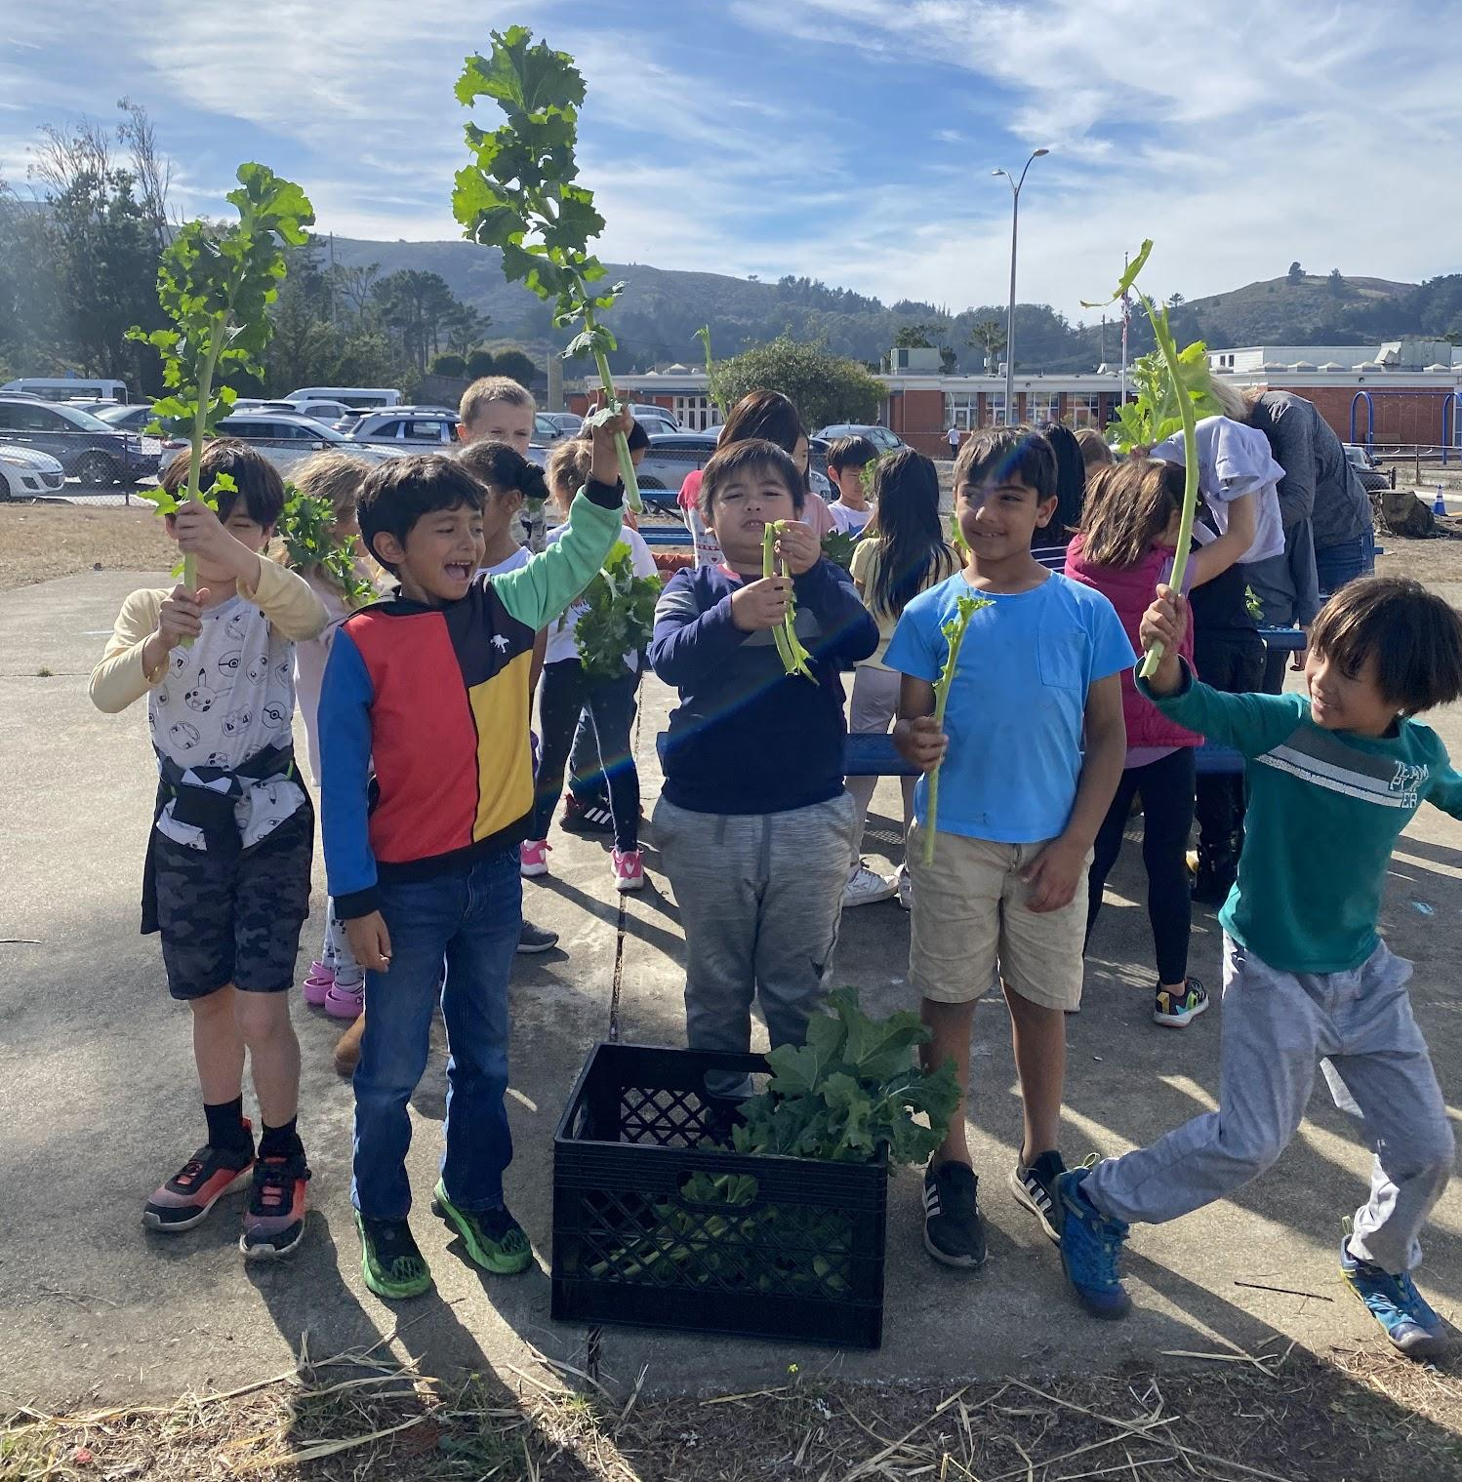
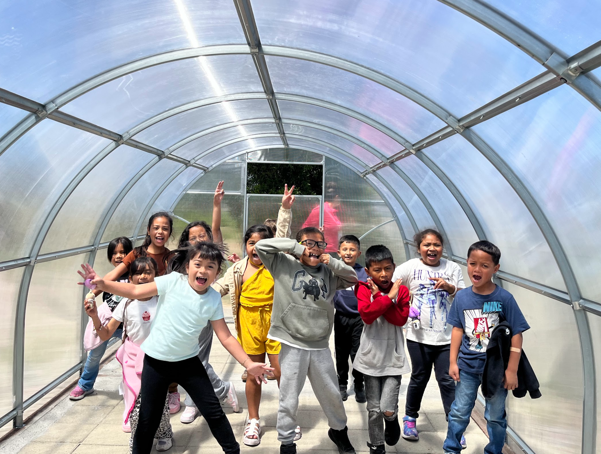
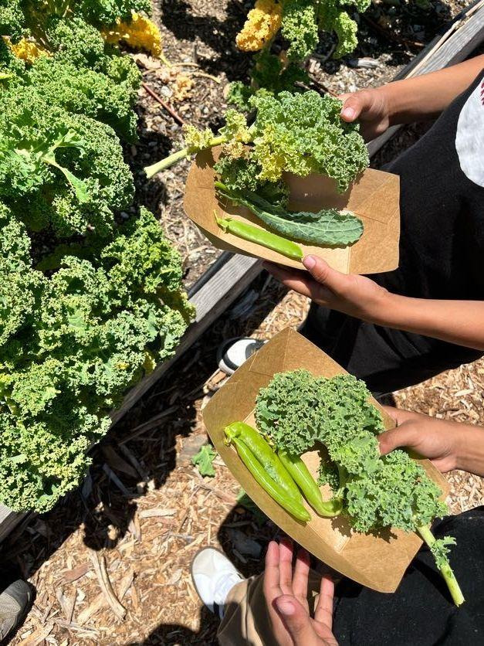

Slide 21
2025-26 PTO Community Events - All Events are on Konstella
Burgers & Bikes
Sun, September 13
Scholastic Book Fair
October 19 - 22
Fall Fest
Thu, October 22
  BBQ & Treats
  Book Fair
  Festival Fun
Family Dance
Fri, February 5
Auction & Dinner Dance
Sat, April 3
Spring Play
March 19, 20, & 21, 2027
Spring Fest
Sat, May 8
  Science Saturday
  Art Show
  Used Book Sale
Jogathon
Fri, May 21
Field of Dreams
May 22 - 23
Notes:
Pam to make updates per the play & 8th grade Fall Fest.

Slide 22



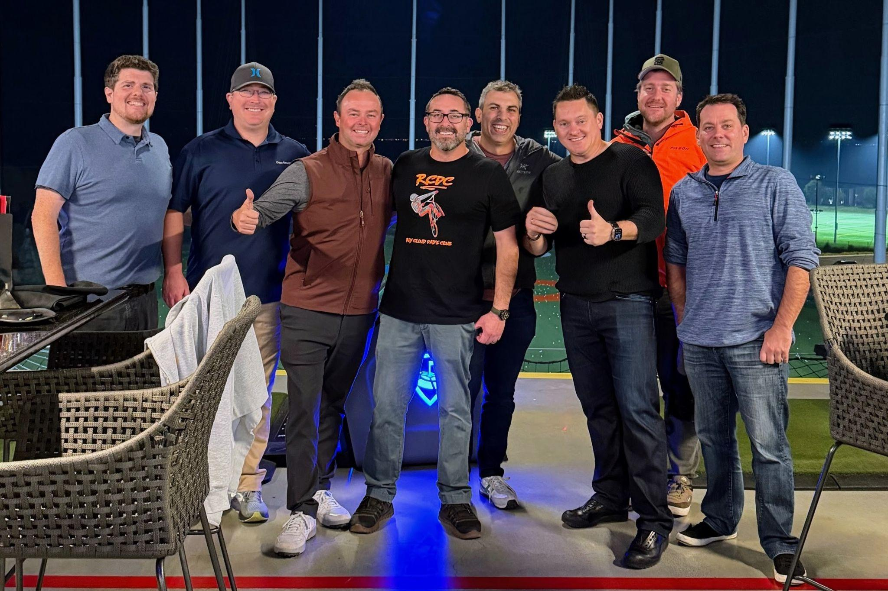



Roy Cloud Dads' Club Overview
Who We Are
A volunteer group connecting fathers and father figures to build community, make friends, and support Roy Cloud students, staff, and the PTO.
Major Signature Events
Burgers & Bikes (Sept 13): Family bike ride & BBQ kickoff at Flood Park.
Field of Dreams (May 22–23): Annual overnight campout on the school field with BBQ, outdoor movie & pancake breakfast.
How We Help Our School
Campus fix-its (Gaga pit & irrigation), hosting interactive science tables at Spring Fest, safety supply checks, and organized dad/kid outdoor hikes.
All Roy Cloud Dads Welcome!
Whether you attend every meeting or help at one event, all dad figures are invited to participate.
See appendix for dates of upcoming events

Slide 23

Ways to Volunteer
Join a committee to support key events:
  Auction Committee volunteers
  Direct Donations Committee
  Jogathon Committee
Sign up (via Konstella) for a shift to help out at:
  Book Fair
  Fall Fest
  Spring Fest
  More to come…
Team up with Dads’ Club
Volunteer in your classroom
  Art
  Garden
info@roycloudpto.com
Remember to get volunteer clearance from the school district! Apply here

Slide 24
PTO Volunteer Opportunities
info@roycloudpto.com
Role | Type | Description
After-School Enrichment Trainee | Programs | Shadow our long-term lead and learn the ropes to take over this important program next year!
No-cost Fundraisers Coordinator | Fundraising | Coordinates Amazon Smile and other promotions that give % of sales to the school. Ex. Mr. Softee’s ice cream truck parked off campus
Safe Routes to School Coordinator | Community | - Organizes walking school bus routes - Organizes walk to school day events like Ruby Bridges, International walk to school day, and Earth day walk - Organizes bike safety training / safe driving pledge - Works with City coordinators on safety improvements around school
Spanish Translation Liaison | Comms | - Reach out to welcome and liaise with Spanish-speaking families - Coordinate translation resources for meetings and materials
Used Book Sale Coordinator | Community | Collect used books, set-up, sales, clean-up, volunteer management, scheduling with teachers
Volunteer Clearance Coordinator | Community | New position to help facilitate a smoother volunteer clearance process

Slide 25
We need YOU!
The role of PTO Treasurer is open. Spend the 2026-2027 school year shadowing our current treasurer, Leanna Staben, and see all the ins and outs of the PTO finances. Then take over the role starting the 2027-2028 school year.
Learn more by contacting Leanna Staben: treasurer@roycloudpto.com

Slide 26
Treasurer Updates
Notes:
Tammi

Slide 27
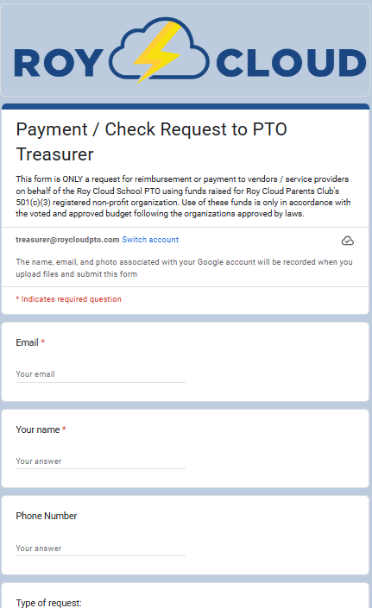
PTO Financial Housekeeping & Guidelines
📌 The Treasurer’s Role
Goal: Managing community funds safely, transparently, and efficiently. Maintaining our 501(c)(3) non profit status & good practices.
Impact: Direct funding for programs like Art in Action, Science from Scientists, teacher stipends, and community events.
⏰ The 1-Month Rule
Advance Notice: Please submit all payment and vendor requests one month in advance.
Why: Standard check processing and mailing takes up to one month. Early submission ensures
zero out-of-pocket delays and timely vendor payments. Last minute emergency payments may text.
📝 How to Request Funds & Reimbursements
Digital First: Complete the online PTO Check Request Form at RoyCloudPTO.com
Receipts Required: Always upload itemized digital receipts or invoices directly into the online form.
Paper Alternative: Print your completed online form, attach physical receipts, and place it in the
Treasurer's Folder in the front office PTO files.
💬 Questions or Support?
Contact me directly at treasurer@roycloudpto.com for budget inquiries, check statuses, or other treasury related questions.

Slide 28
Treasurer Updates
🗳️ Budget Voting & Timeline
Review Today: We are reviewing the proposed budget at this meeting.
Vote Next Week: All members will cast their votes online next week.
Action Required: Keep an eye out for the upcoming Konstella notification with the voting link.
📋 Responsibilities for Committee Leads & Chairs
W-9 Forms Required: You must obtain a W-9 form from any independent contractor or small business we use or have contract with and forward it to the Treasurer immediately for tax processing (1099s).
Timely Payments: It is your responsibility to ensure all payment and reimbursement requests match the invoice/contract terms and are submitted on time.
🔒 Official Organization & Tax Details
Legal Name & EIN: Roy Cloud School Parents’ Club | EIN: 26-4393209
Non-Profit Discounts: Please do not apply for any tax-exempt or non-profit discounts without prior Treasurer consent and awareness.
Tax Season: Our official annual taxes and financial audit will take place over the next month.
👋 Looking Ahead: Open Treasurer Position
Succession Planning: The PTO is looking for a new Treasurer for next school year.
Interested? If you love staying organized and want to give back to the school, please reach out to me privately at treasurer@roycloudpto.com to chat about what the role involves!

Slide 29
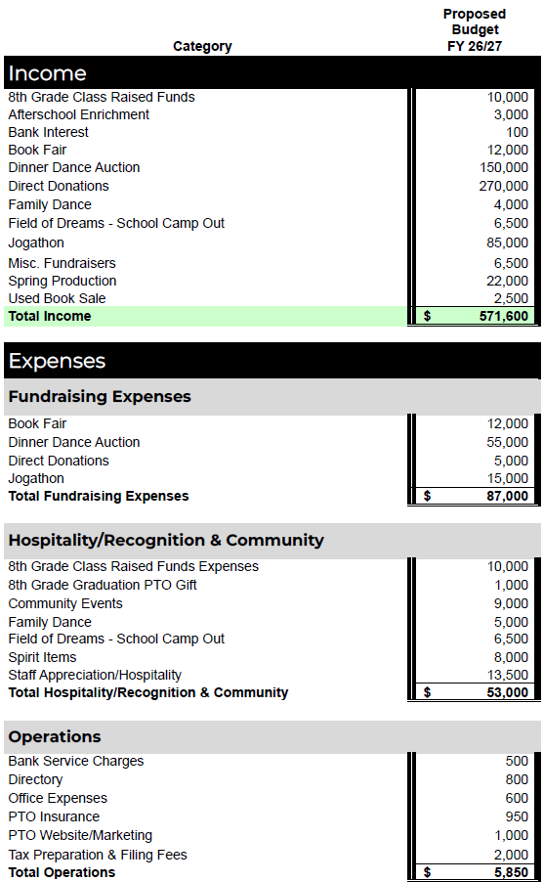
Proposed Budget
FY 2026-2027
May 2026 Baseline: The current foundational budget was approved in May 2026 for the 2026–2027 fiscal year.
Proposed Adjustments: Updates were made to reflect the finalized carryover from last year and updated school needs.
Added 5K to auction expenses;
Increase in vendor costs
Added 1K to community events;
Increase in vendor costs
+2K to Spirit wear; often underestimated
+1.5K to staff appreciation/hospitality

Slide 30
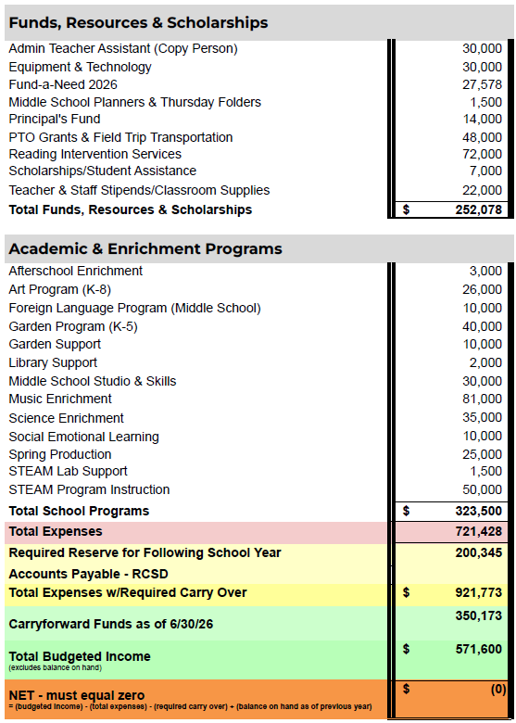
Proposed Budget
FY 2026-2027
Continued
Added 5K for Copy Person for COLA
Added 2K to Scholarships; help
–Added 9K to Music for instruments
–Added 2K to Science for additional enrichment for grades not receiving Science From Scientists lessons
Adjusted to cover a portion of staff positions for following school year
Balance in all accounts at end of 2025-26 school year

Slide 31



PTO Budget: Annual Revenue Goals
Our greatest sources of revenue.
DIRECT DONATION DRIVE
AUCTION
JOGATHON
$270,000
$150,000
$85,000
Primary source of annual funding
April 3, 2027
Fun-run in spring
Target Annual Revenue:
$571,600

Slide 32
Message from the Principal
Notes:
Tammi

Slide 33
Frequently asked questions
How do I stay updated on school news?
Read Principal Bowdoin’s Cloud Chronicles emails and Join Konstella! All PTO announcements, event signups, and parent discussions take place on the Konstella platform.
What does the Direct Donation Drive support?
PTO funding provides nearly $1,000 per student in enrichment including Art in Action, field trips, STEAM supplies, and classroom grants.
How do after-school enrichment programs work?
Classes run after dismissal. TK & K students escorted to their program, 1st grade and above walk to the classroom, check homeroom!
How do I know if I’m cleared to volunteer?
Once all items are into the district, they inform the school on a spreadsheet. If you are curious if you’ve been cleared, please contact the district or our school office. See clearance process on the next slide.
Why are school supply lists posted just before school starts?
The school is still working on them up until the last minute. We want to be sure we are only asking families for essential items.
How do I report my child as absent?
Report it via the SchoolMessenger app, call the front office, or login to the SchoolMessenger website (see next slide for links).

Slide 34
Volunteer Clearance FAQ
Level 1 Volunteer:
Level 1 volunteers are not permitted to be alone with students out of the direct supervision of the teacher. Ways to participate: Art in Action.
Submit a completed volunteer application (link found here) and attach the following documents:
A copy of your current Driver’s License or other government issued ID
A copy of Tuberculosis clearance (within 60 days)
Level 2 Volunteer:
Level 2 volunteers are those who may supervise small groups of students in class or on school bus activities away from campus, or who, at any time, are alone with students outside the supervision of a certified school employee. Ways to participate: Volunteer in the garden class, chaperone on Field Trips.
Complete a LIVESCAN (fingerprinting). *Note: completed in person.
Complete Mandated Reporter Training for volunteers: https://mandatedreportertraining.com/california/. There is a $10 fee to take the exam and download the certificate. *Note: approximately 2hrs time commitment.
Submit your complete volunteer application online. Attach a copy of your driver’s license/passport, TB clearance, Mandated Reporter certificate, & copy of completed LIVESCAN form. *Note: application must be submitted within a few days of completing LIVESCAN.
Note:
All required forms can be found on the Volunteer application on the Redwood City School District website.
This process takes time, get started now!

Slide 35
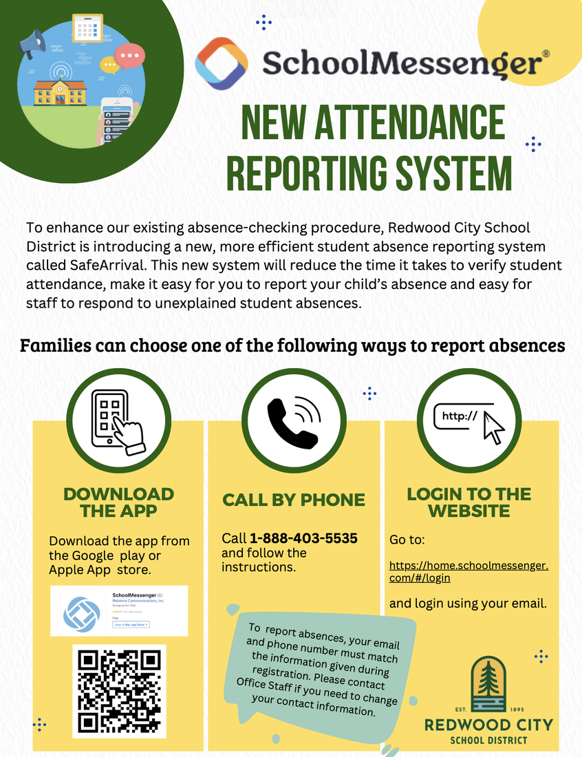

Slide 36
See you at our next meeting!
November 10, 2026
🌐 www.roycloudpto.com
✉ info@roycloudpto.com
Connect with Roy Cloud PTO:

Slide 37
Appendix
Notes:
Tammi

Slide 38
Why the PTO Matters
Public school is not the same as when you were growing up
Public schools in California are underfunded
Most “extras” have been cut from school budgets
PTOs/PTAs have become the lifelines to schools, filling the funding gap
  Fund programs previously paid for by the state
  Support core instructional programs
  Bring back essential enrichment
  Fund critical services
  Support teachers and administration

Slide 39
2026–2027 Dad’s Club Schedule of Events
Date | Time | Event / Activity
Sunday, Sept 13, 2026 | 1:00 PM – 4:00 PM | Burgers & Bikes @ Flood Park
Thursday, Sept 24, 2026 | 6:00 PM – 8:00 PM | RCDC Monthly Meeting
Wednesday, Oct 21, 2026 | 6:00 PM – 8:00 PM | RCDC Monthly Meeting
Thursday, Nov 19, 2026 | 6:00 PM – 8:00 PM | RCDC Monthly Meeting
Wednesday, Dec 16, 2026 | 6:00 PM – 8:00 PM | RCDC Monthly Meeting
Thursday, Jan 21, 2027 | 6:00 PM – 8:00 PM | RCDC Monthly Meeting
Spring 2027 | TBD | Spring Fest Science Tables, Monthly Meetings & Social Events
May 22–23, 2027 | Overnight | Field of Dreams Family Campout
For meeting details and updates, check Konstella.

